Slide 1
Ticket Pricing Model for Big Mountain Resort
Binod Neupane
Data Analyst

Slide 2
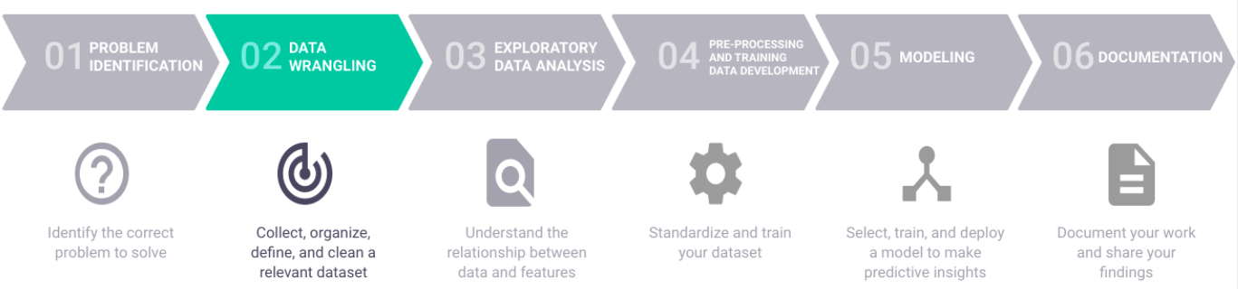
Problem Identification
Background
Mountain Resort has a wide range of resources for skiers; however, the resort is not sure if it is best capitalizing its resources for business.
The resort wants to identify the facilities that matter most to visitors and features that visitors would pay more
By utilizing the available data this project aims to build a predictive model for ticket price based on several facilities, or properties, boasted by resorts.
Approach
Data collection: Resort key features, including price, across the market
Data wrangling and exploratory analysis: cleaning data and evaluating the relationship among features with respect to the ticket price
Data pre-processing: identify important resort features that affect the ticket pricing model
Data modeling: develop predictive pricing model based on the key resort features

Slide 3
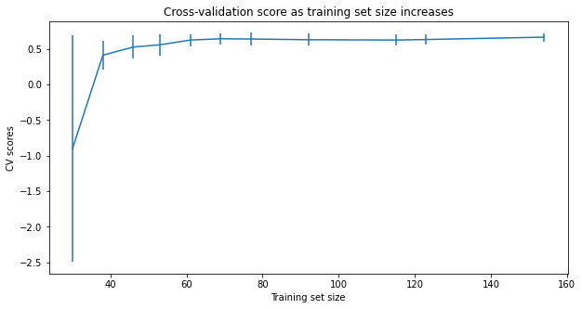
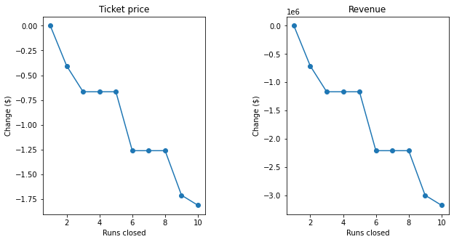
Modeling and Analysis
Used a test/train partition of 70/30.
Calculated and compared the R-squared value, mean squared error value, and mean absolute error between test ad the predictive models.
Random Forest Model was used to assess performance using cross-validation. Further, several hyperparameters (with and without feature scaling, and both the mean and median as strategies for imputing missing values) were explored to validate the predictive model.
The random forest model has a lower cross-validation mean absolute error by almost $1.

Slide 4
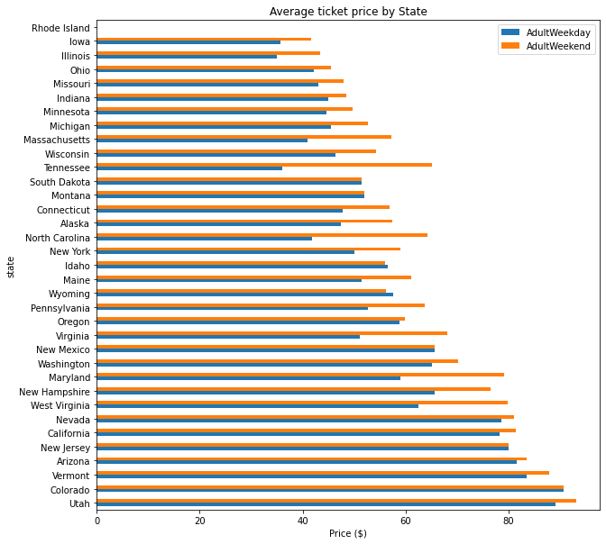
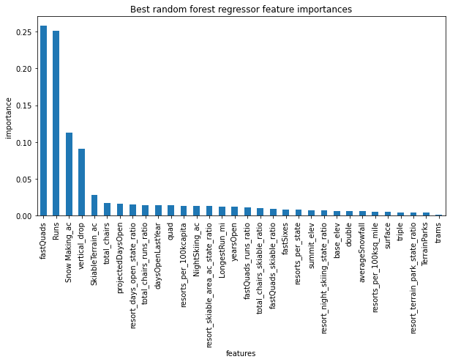
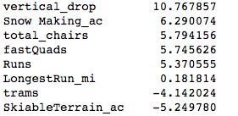
Modeling and Analysis

Slide 5
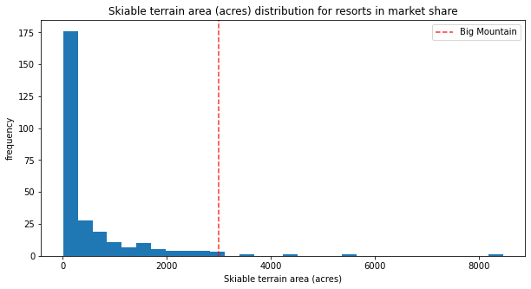
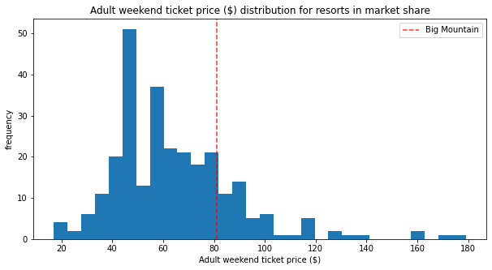
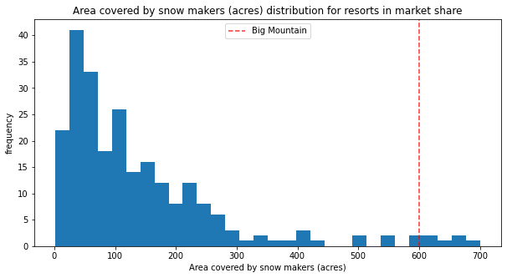
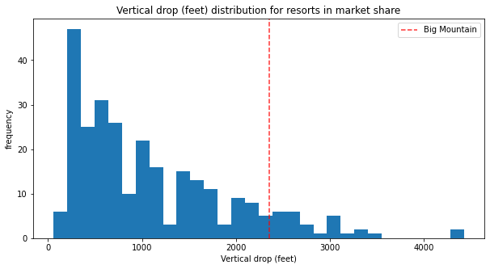
Modeling and Analysis

Slide 6
Recommendation and Key Findings
The following features were identified as the most important features that affect the ticket pricing of the resort
Vertical drop; Snow making accumulation; Total chairs; Fast Quads; Runs; Longest runs; Trams; Skiable Terrain
The Big Mountain Resort modelled price is $95.87, actual price is $81.00. The model suggests that there is room to increase the ticket price.
Closing a single run makes no difference in ticket price and revenue. However, closing 2 and 3 successively reduces support for ticket price and revenue.
If the resort plans to close 3 runs, the model suggests that closing addition 4 or 5 runs has no further loss in ticket price. On the other hand, when the closures are increased to 6 or more, the ticket price and subsequent revenue drops significantly.
So, it is recommended that the resort can close up to 5 runs to cut the cost.
Increasing the vertical drop by adding a run to a point 150 feet lower down and installing an additional chair lift could increase the current ticket price by $8.61, which could result total revenue of $15,065,471. Furthermore, adding two acres of snow making cover results additional $1.29 per ticket and additional revenue of $2.2M.
Increasing the longest run by 0.2 mile to boast 3.5 miles length, requiring an additional snow making coverage of 4 acres does not change in ticket price.

Slide 7
Summary and Conclusions
The Big Mountain Resort modelled price is $95.87, actual price is $81.00. The model suggests that there is room to increase the ticket price.
The Resort can decide its pricing strategy based on the model developed.
The predictive model is robust as it seen in model cross validation.
The model does not capture operating costs of resorts, when included the results may look different.
The number of visitor data is also lacking in the model. This information could give further insights.

